Slide 1
Monocular SLAM in C++ 24-783: Advanced Engineering Computation Team : Will Code for Food
- Aditya Ramakrishnan - Neel Pawar - Samiran Gode

Slide 2
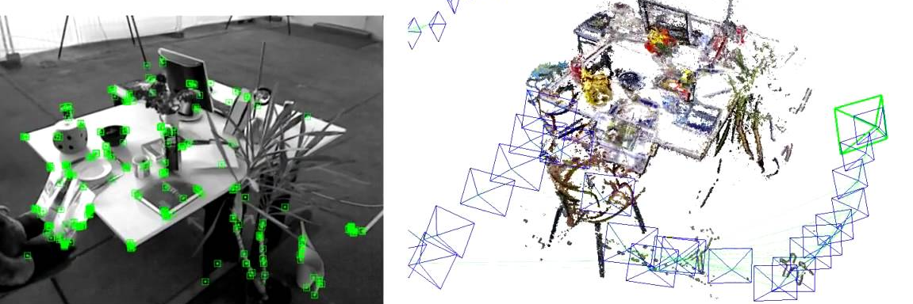
Introduction to SLAM
SLAM is the computational problem of constructing or updating a map of an unknown environment while simultaneously keeping track of an agent's location within it.
2
Notes:
Why this problem? Eye in Hand
For larger FOV’s, the robot can reorient for imaging from afar (helps even with robot interfering occlusions).
Imaging an object from multiple viewpoints allows a more complete 3D model (can also mitigate problems with specular reflections).
Disadvantages?
Payload reduced due to existing camera weight.
Image capture only when stationary.

Slide 3
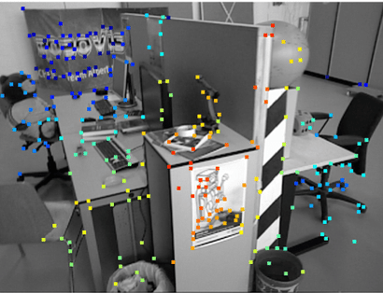
Project Overview
Goal:
Build and deploy a small-scale monocular SLAM system for static environments
Dataset considered:
T.U. Munich - RGBD dataset
Primary functionality:
Feature detection & tracking,
Camera poses estimation & mapping
3
Notes:
Why this problem? Eye in Hand
For larger FOV’s, the robot can reorient for imaging from afar (helps even with robot interfering occlusions).
Imaging an object from multiple viewpoints allows a more complete 3D model (can also mitigate problems with specular reflections).
Disadvantages?
Payload reduced due to existing camera weight.
Image capture only when stationary.

Slide 4
Approach

Slide 5
Methodology
Dataset: Take in image frames
Frontend detector: Detects keypoints
Frontend tracker: Track keypoints across frames
Viewer: Visualize tracked data
Multithreading: Controller operations
Backend: Smoothing and mapping
5
Notes:
To perform the calibration involves a robot making a series of planned movements - At the end of each movement, the camera takes an image of the calibration object - The calibration object pose is extracted from the image, and the robot pose is registered from the controller. - To achieve good calibration quality, the robot poses used when the camera takes images of the calibration object should be: - sufficiently distinct - using all the robot joint results in a diversity of perspectives with different viewing angles
At the same time, the calibration object should be fully visible in the field of view of the camera task is then to solve homogeneous transformation equations to estimate the rotational and translational components of the locations of the calibration object and those of the hand-eye transformation.

Slide 6
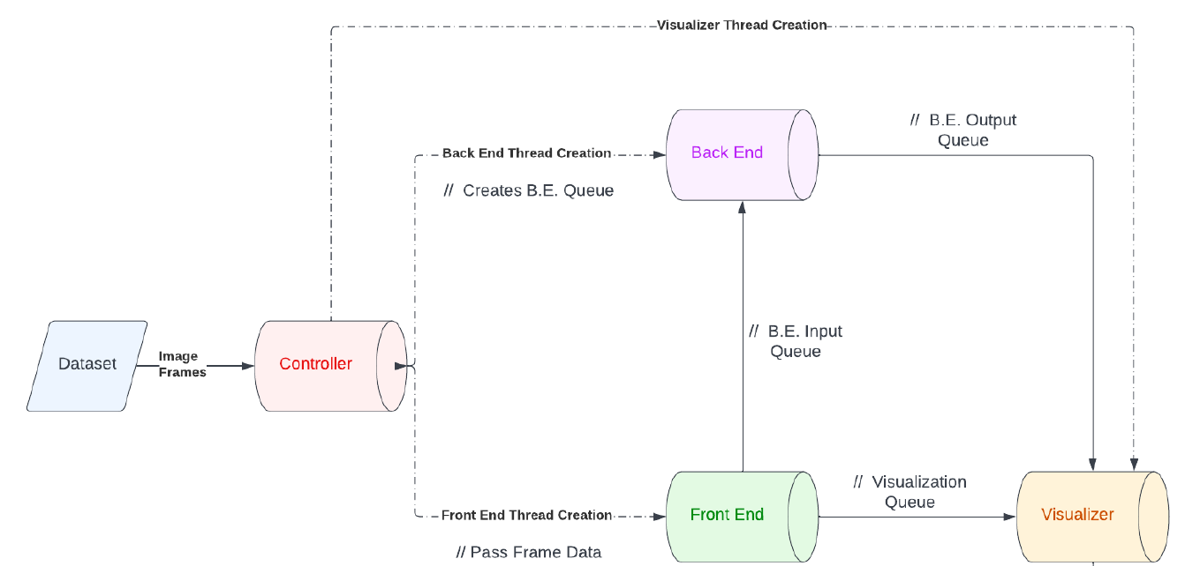
Data Pipeline
Notes:
Move the robot to a new posture
Register the end-effector pose
Image the calibration object (obtain its pose)
Repeat steps 1-3 multiple times, e.g. 10 - 20
Compute hand-eye transform

Slide 7
System Setup

Slide 8
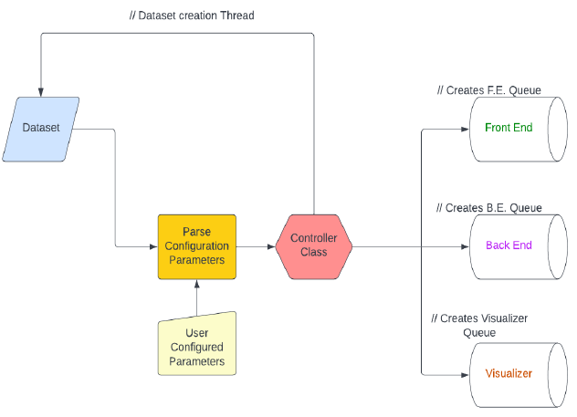
System Description
Input: TUM Dataset (RGB images only)
Controller: Thread creation across each sub-component class
Data processing: - Frontend thread processes image-frames - Backend thread processes frontend output
Output: Pangolin viewer combines image data and localization map generated.
8

Slide 9
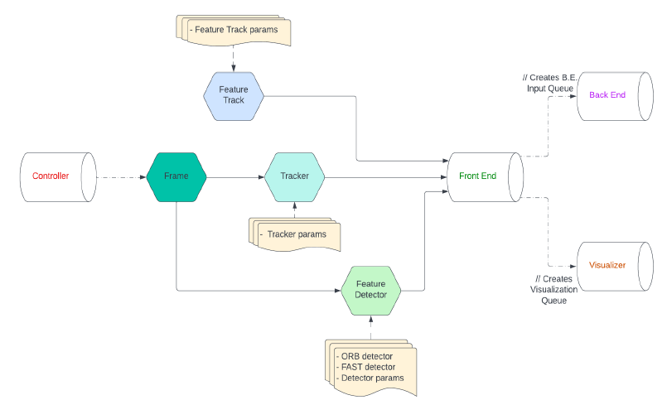
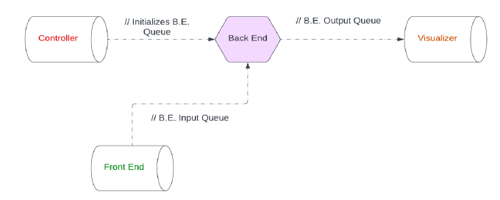
Monocular-SLAM Data Processing
9

Slide 10
Results

Slide 11
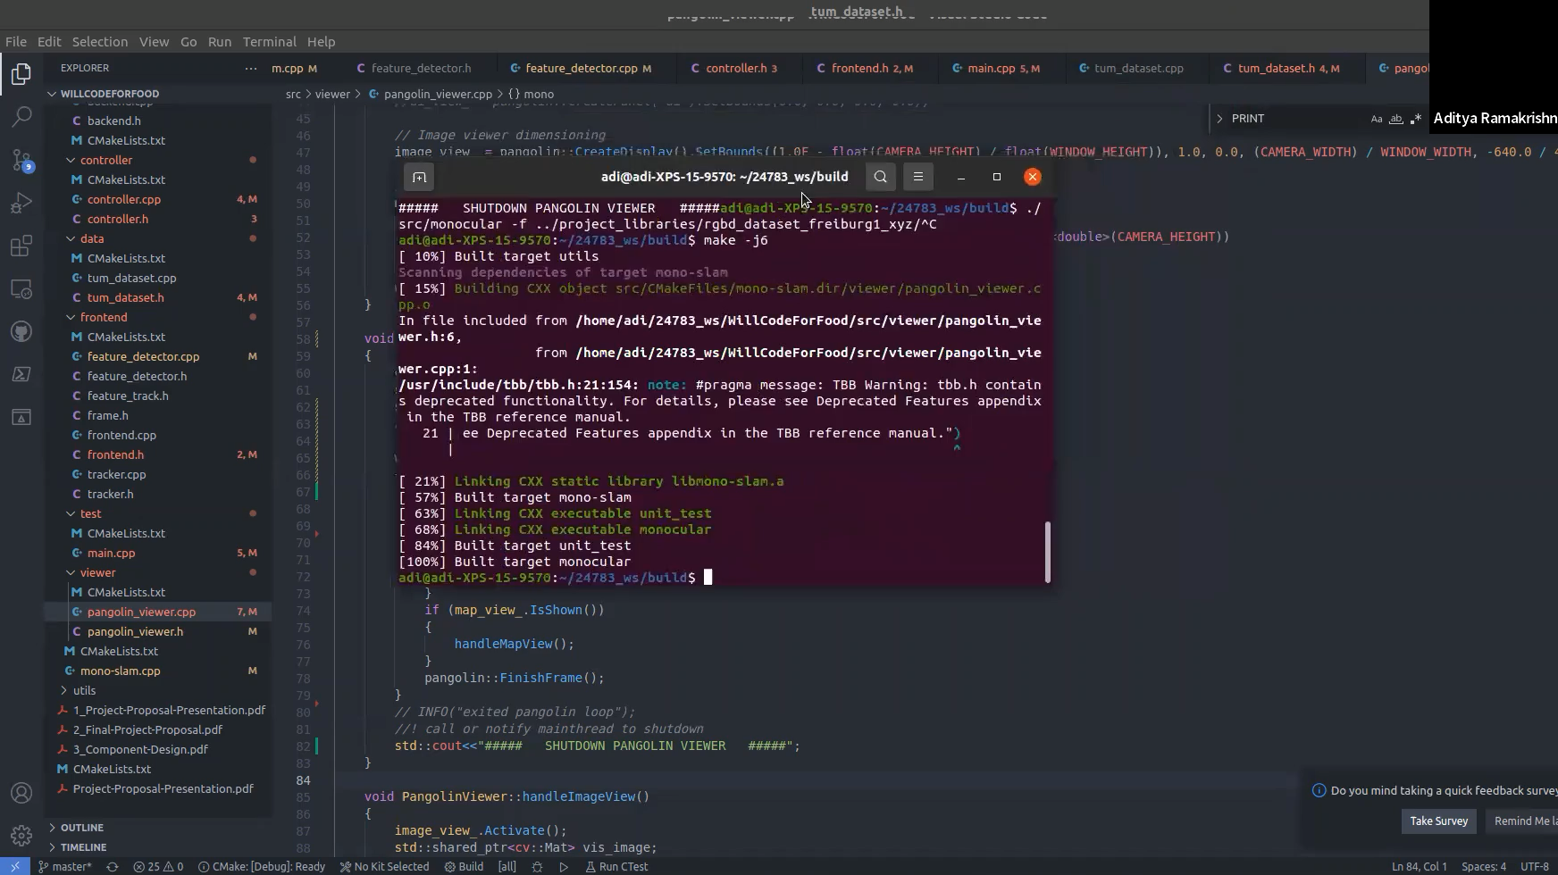

Slide 12
Results: Localization
From the demo, we can see that the localization of the camera position and orientation is fairly good.
Although the we cannot move around the map interactively, we are able to gain a reasonable understanding of how the camera pose shifts over time.
Additionally, the visualization also clearly indicates optical flow properties of detected features.
12

Slide 13
Roadblocks & Challenges

Slide 14

Roadblocks & Challenges
Poor documentation : Despite this implementation of ORB-SLAM being widely derived from, a source of collated documentation that is coherent is still hard to come by.
Library specific dependencies : plethora of libraries make it quite challenging to implement a comprehensible ORB Slam module that is easily deployable.
Cross platform issues : different OS’ as well different OS versions prove to be a challenging issue in common SLAM implementations.
With this in mind, we have attempted to implement a modular and clean system, that can be fairly easily installed and is ready to be deployed.
14
Notes:
Firstly, very few calibration methods based on SLAM, and barely any with open-sourced, well-documented codebase.
Temperature, joint friction, payload, and manufacturing tolerances are some of the factors that cause the robot to deviate from its preprogrammed positioning.
If the robot loses the calibration, the picking accuracy will deteriorate. Repeating the calibration (robot and/or hand-eye) can compensate for such deteriorated performance.

Slide 15
Thank You

Slide 16
Contribution
Most importantly, we were a strong team and each one took charge and handled the project in difficulties and time of need.
Samiran Gode:
Team Lead, Front-End + Back-End development, Unit Tests
Aditya Ramakrishnan:
Pangolin Viewer + Controller development, Presentation + Report
Neel Pawar:
Dataset + Front-End development, Process Documentation
16
Notes:
Firstly, very few calibration methods based on SLAM, and barely any with open-sourced, well-documented codebase.
Temperature, joint friction, payload, and manufacturing tolerances are some of the factors that cause the robot to deviate from its preprogrammed positioning.
If the robot loses the calibration, the picking accuracy will deteriorate. Repeating the calibration (robot and/or hand-eye) can compensate for such deteriorated performance.

